Slide 1

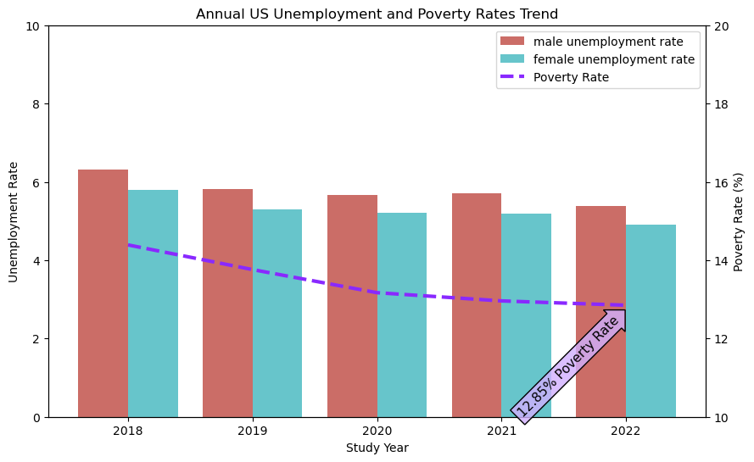
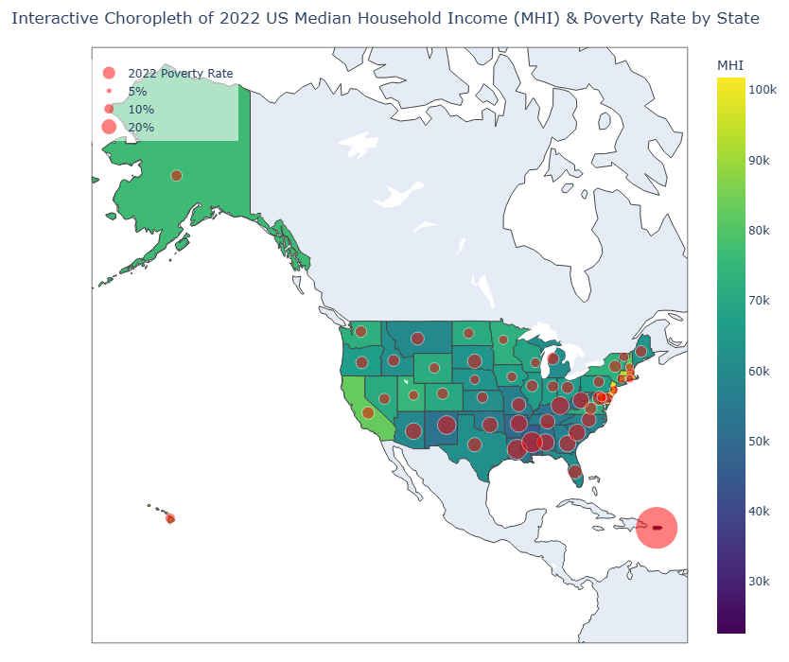
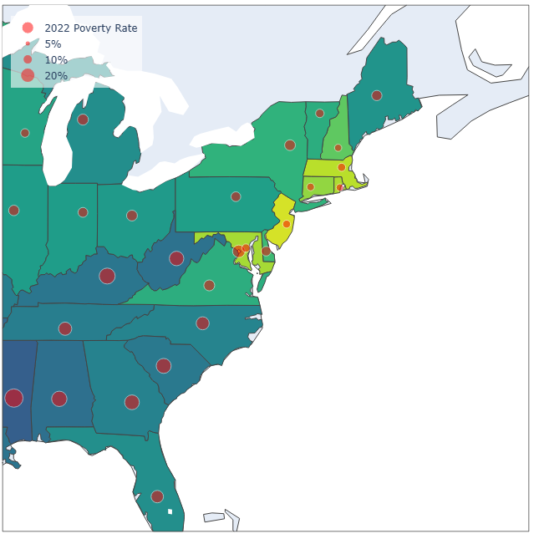
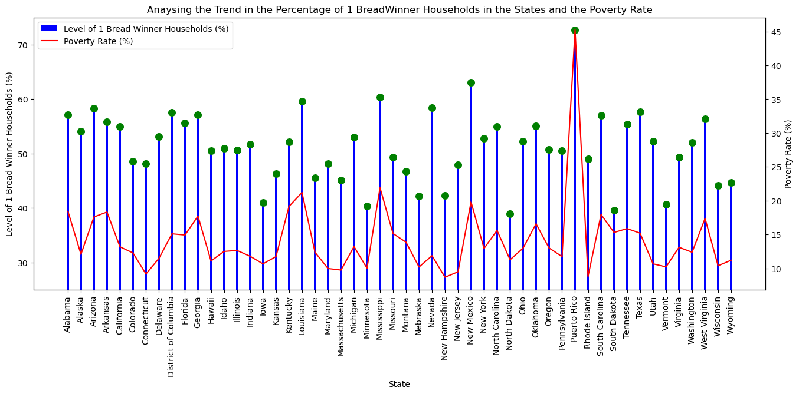
Student ID
EXPLORING THE SOCIO-ECONOMIC DETERMINANTS OF POVERTY ACROSS THE UNITED STATES
Poster Presentation of the Findings from the Analysis of the U.S.A National Child-care Prices Database (2018 To 2022)
250154591
Introduction
Key Objectives of the Analysis
Methodology
A multivariate data analysis of the United States of America National Database of Childcare Prices 2022 dataset to understand some key socio-economic variables and their influences on poverty rate levels across the Counties and States in the Country.
Analyse the US unemployment rate of males and females across 5 years (2018 to 2022).
Analyse the median household income per State against the poverty rate per State.
Analyse the proportion of single-earner households and the poverty Rates in each State
Data Collection: The primary dataset used is the US National Database of Childcare Prices dataset. The U.S states’ GeoJSON map data and the geo-location centroids data were also gotten to aid in the visualisations. All the datasets are publicly available and open source.
Data Processing: The primary dataset was cleaned and processed to derive new variables that aided the analysis. The resulting dataset had 16103 rows and 15 columns.
Data Visualisation and Analysis: Thorough analysis was performed to fulfil all the objectives and produce the outcomes detailed in this poster.
Analysing the Annual Unemployment and Poverty Rates
Analysing Median Household Income and Poverty Rate per State
Conclusions
There was a steady decline of average unemployment rate in the United States across both genders from 2018 to 2022 with a year-on-year decrease of -0.23%, the poverty rate also had a yearly decline rate with almost the same magnitude with a year-on-year decrease of -0.39%. The lowest being 2022 that has average poverty rate of 12.85%, male unemployment rate of 5.3% and female unemployment rate is 4.9%.
New Government initiatives for job creation in the States may further help improve the socio-economic state in many regions and reduce the poverty rate e.g. in Puerto Rico.
Reforms in Government resource allocation may lead to better wealth distribution among the States, especially for States in the Southern region.
Public awareness campaigns on the benefits of dual-earner households could help reduce poverty levels in States.
Eastern Region
Puerto Rico
Poverty Rate: 43.38%
Median Household Income: $22,524.21
Proportion of Single-Earner Households on Poverty Rates
References
The combined graph indicates that poverty rates have a correlation with the proportion of single-earner households raising kids below the age of 18 across the States. Especially in Puerto-Rico where over 70% households of has only one working parent.
U.S. Department of Labor (2024) National Database of Childcare Prices (NDCP) 2022 dataset. Available at: https://www.dol.gov/sites/dolgov/files/WB/NDCP2022.xlsx (Accessed: 25 March 2026).
PublicaMundi (2014) US States GeoJSON dataset. Available at: https://raw.githubusercontent.com/PublicaMundi/MappingAPI/master/data/geojson/us-states.json (Accessed: 18 April 2026).
Google Inc. (2024) US states dataset (state.csv). Available at: https://developers.google.com/public-data/docs/canonical/states_csv (Accessed: 18 April 2026).
The combined choropleth and bubble map visualisation above, shows the spread of the median household income across the states and compares them with their poverty rates.
Many of the southern States in the US appears to have averagely lower median household income compared to the other regions. Same with the poverty rates.
The visualization also suggest that eastern coastal States have higher median household incomes compared to other States.
The State of Puerto Rico has the highest poverty rate of 43.38% and the lowest median household income of $22,524.21 in the country.

